Slide 1
Synthesis of Correlated Bit Streams for Stochastic Computing
Yin Liu, Megha Parhi, Marc D. Riedel and Keshab K. Parhi
Department of Electrical and Computer Engineering
University of Minnesota, Minneapolis MN, USA

Slide 2
Outline
Introduction
Analysis of stochastic logic with correlated inputs
Synthesis of two correlated stochastic bit streams
Synthesis of three correlated stochastic bit streams
Experimental results
Conclusion

Slide 3
Stochastic Computing
Stochastic number can be represented in two formats, where each bit has the same weight.
Unipolar: $x=P\left(X=1\right)=P(X)$ and $x∈[0,1]$
Bipolar: $x=2P\left(X=1\right)−1=2P\left(X\right)−1$ and$x∈[−1,1]$
* B. Gaines, “Stochastic computing systems,” in Advances in information systems science, pp. 37–172, Springer, 1969.

Slide 4
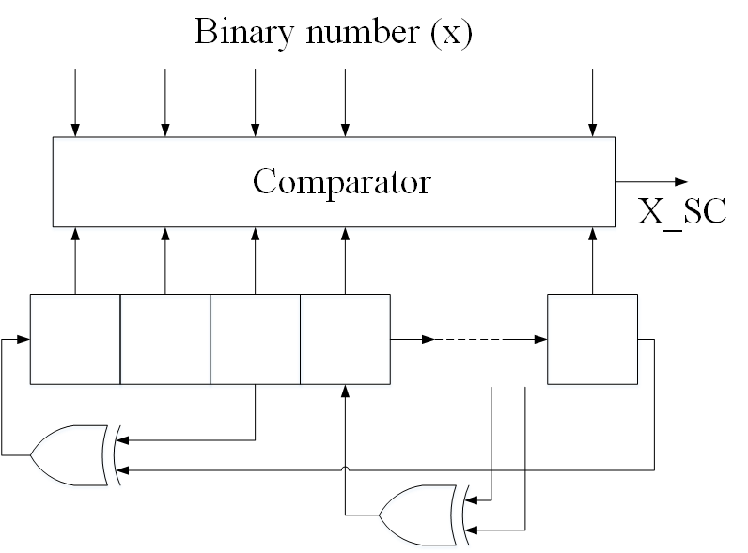
Stochastic Logic
The stochastic number generator (SNG) is implemented using a linear feedback shift register (LFSR) and a comparator.

Slide 5
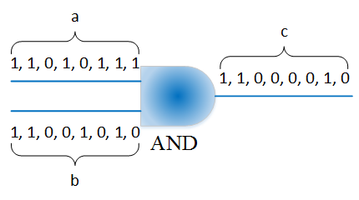
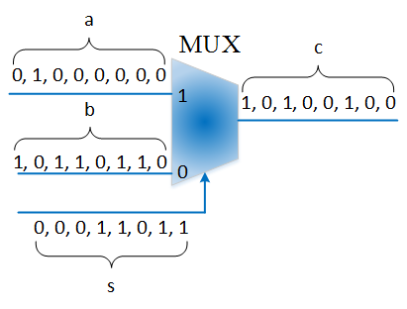
Stochastic Logic (continued)
Stochastic arithmetic implemented with combinational logic:
Multiplication: $P\left(C\right)=P\left(A\right)⋅P\left(B\right)=\frac{3}{4}×\frac{1}{2}=\frac{3}{8}$
Scaled addition: $P\left(C\right)=P\left(A\right)⋅P\left(S\right)+P\left(B\right)⋅\left(1−P\left(S\right)\right)$
$=\frac{1}{2}\left(P\left(A\right)+P\left(B\right)\right)=\frac{1}{2}×\left(\frac{1}{8}+\frac{5}{8}\right)=\frac{3}{8}$
(a) Multiplication in unipolar format
(b) Scaled addition

Slide 6
Motivation and Objective
In stochastic logic the deviation from exact values increases as the correlation among inputs increases.
Testing correctness of stochastic computing circuits requires generation of correlated stochastic bit streams.
The notion of stochastic correlation and a method to generate correlated bit streams using probabilistic transfer matrices have been proposed *
Our objective is to generate correlated bit streams based on the traditional Pearson correlation.
* A. Alaghi and J. P. Hayes, “Exploiting correlation in stochastic circuit design,” in 2013 IEEE 31st International Conference on Computer Design (ICCD), pp. 39–46, 2013

Slide 7
Outline
Introduction
Analysis of stochastic logic with correlated inputs
Synthesis of two correlated stochastic bit streams
Synthesis of three correlated stochastic bit streams
Experimental results
Conclusion

Slide 8
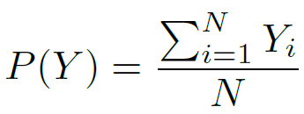
The output error of stochastic combinational logic
Under the assumption of uncorrelated inputs:
$Y$: the output bit stream in unipolar format
$Y_{i}$: each bit of $Y$ represented as an independent identically distributed (i.i.d.) Bernoulli random variable with probability of one equal to $p_{Y}$
The number represented by $Y$:
The computation error is given by the variance of a binomial distribution

Slide 9
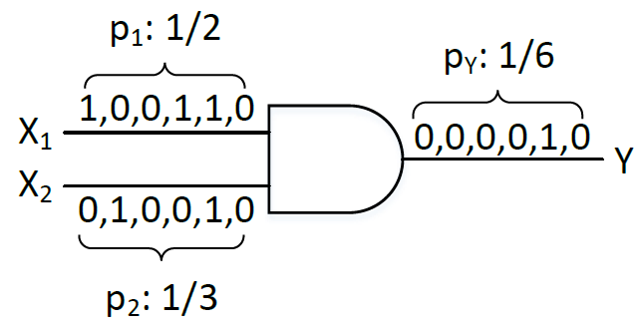
Stochastic combinational logic with two correlated input sequences
Consider the following example
The output probability is given by
If two inputs are correlated at the bit-level, the expected value of the output will change.

Slide 10
Stochastic combinational logic with two correlated input sequences
More 2-input stochastic logic gates

Slide 11
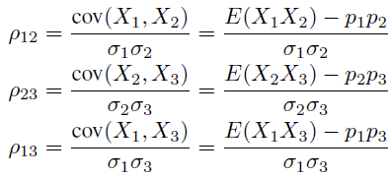
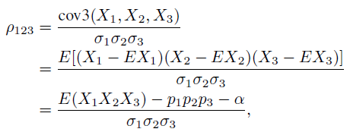
Stochastic combinational logic with three correlated input sequences
Consider the unipolar stochastic multiplication with 3 inputs
Three inputs $X_{1}$, $X_{2}$ and $X_{3}$, where $E\left(X_{i}\right)=p_{i}$
Correlations of three inputs are described using pairwise correlations and one cubic correlation
where $α=ρ_{12}σ_{1}σ_{2}p_{3}+ρ_{23}σ_{2}σ_{3}p_{1}+ρ_{13}σ_{1}σ_{3}p_{2}$ and $σ_{i}=\sqrt{p_{i}(1−p_{i})}$

Slide 12
Stochastic combinational logic with three correlated input sequences
The output probability:
The computational error:

Slide 13
Outline
Introduction
Analysis of stochastic logic with correlated inputs
Synthesis of two correlated stochastic bit streams
Synthesis of three correlated stochastic bit streams
Experimental results
Conclusion

Slide 14
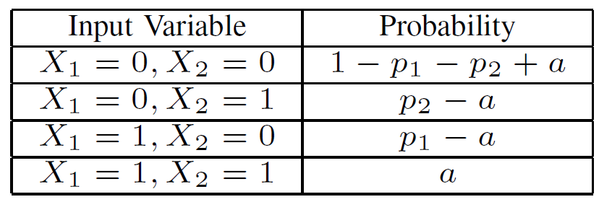
Synthesis of two correlated stochastic bit streams
Let $p_{1}$, $p_{2}$ and $ρ$, respectively, represent the given probabilities of ones in the stochastic sequences $X_{1}$, $X_{2}$, and their correlation coefficient.
Our objective is to synthesize two stochastic sequences given parameters $p_{1}$, $p_{2}$ and $ρ$.
The joint probability mass function (pmf) of $X_{1}$ and $X_{2}$ is described as follows:

Slide 15
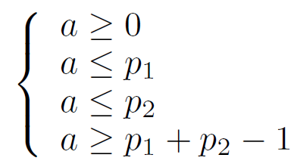
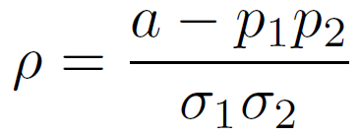
Synthesis of two correlated stochastic bit streams (continued)
Constraints for non-negative probabilities:
From the definition of the bit-level correlation:
Since $a≥max(0, p_{1}+p_{2}−1)$ and $a≤\min\left(p_{1},p_{2}\right)$, the feasible range of $ρ$ is given by

Slide 16
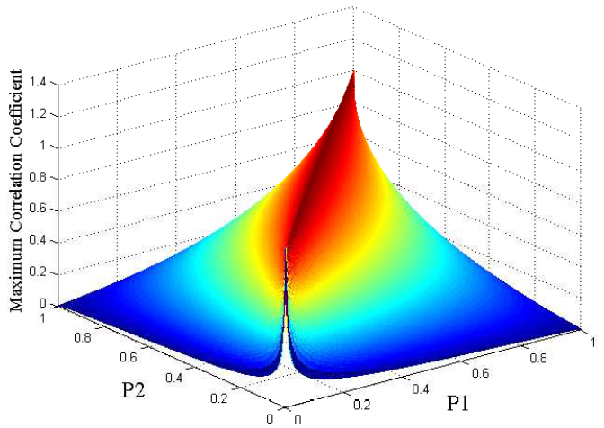
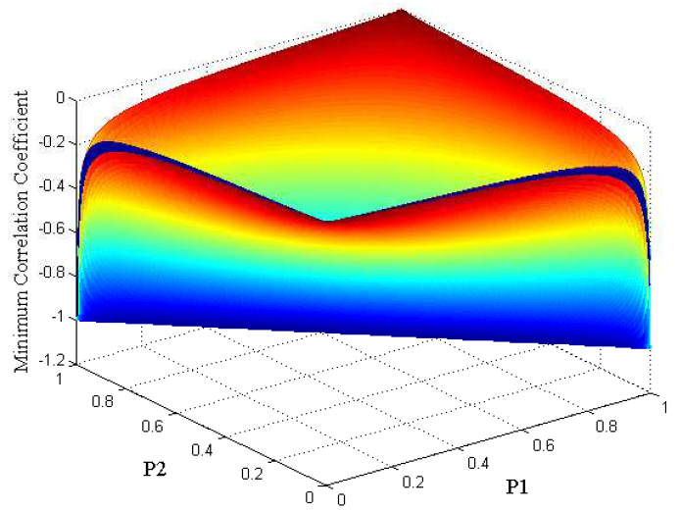
The feasible range of $ρ$
For example, if $p_{1}=0.3$ and $p_{2}=0.8$, the range of $a$ is constrained to the range $[0.1, 0.3]$. This limits the range of $ρ$ to $[−0.7638, 0.3273]$
The minimum $ρ$ and the maximum $ρ$ for all possible combinations of $p_{1}$ and $p_{2}$

Slide 17
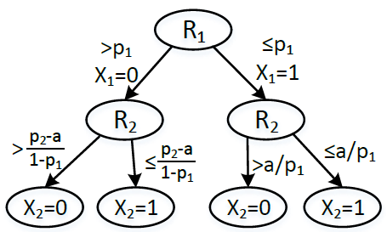
The decision tree
The two correlated stochastic bit streams, $X_{1}$ and $X_{2}$, are synthesized from two uncorrelated bit streams, $R_{1}$ and $R_{2}$, where each bit of $R_{1}$ and $R_{2}$is a uniform random variable between 0 and 1.

Slide 18
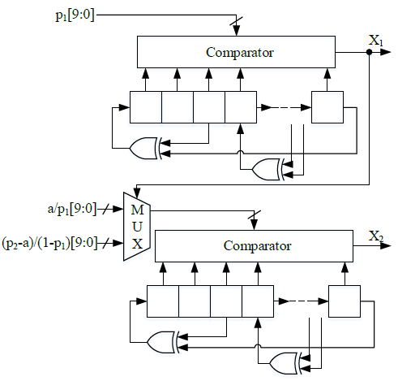
The circuit for synthesis two correlated bit streams

Slide 19
Outline
Introduction
Analysis of stochastic logic with correlated inputs
Synthesis of two correlated stochastic bit streams
Synthesis of three correlated stochastic bit streams
Experimental results
Conclusion

Slide 20
Inputs for synthesis of three correlated bit streams
Inputs include probabilities and correlations
The joint probability mass function (pmf) of $X_{1}$, $X_{2}$ and $X_{3}$ is described as follows:

Slide 21
Inputs for synthesis of three correlated bit streams (Continued)
Parameters $a$, $b$, $c$ and $d$ are described as follows:

Slide 22
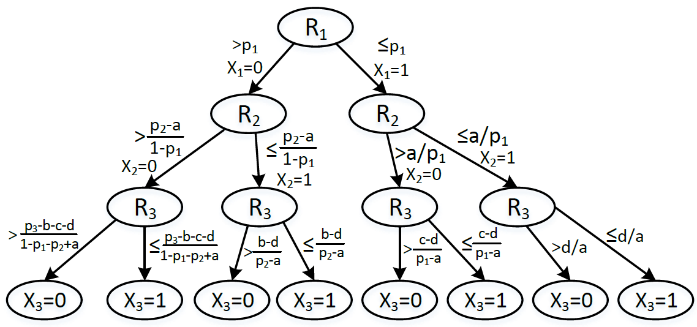
The decision tree
The three correlated stochastic bit streams, $X_{1}$ $X_{2}$ and $X_{3}$, are synthesized from three uncorrelated bit streams, $R_{1}$, $R_{2}$ and $R_{3}$

Slide 23
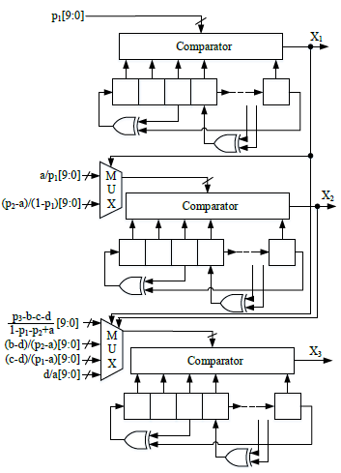
The circuit for synthesis three correlated bit streams

Slide 24
Outline
Introduction
Analysis of stochastic logic with correlated inputs
Synthesis of two correlated stochastic bit streams
Synthesis of three correlated stochastic bit streams
Experimental results
Conclusion

Slide 25
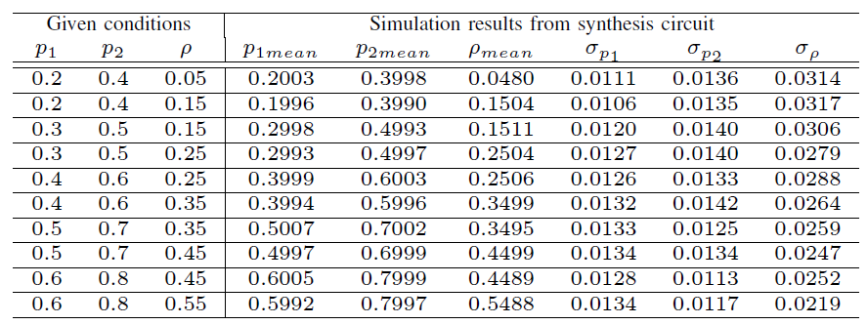
Test for circuits to generate correlated stochastic bit streams
We performed 1000 Monte Carlo runs using the proposed architecture
The length of stochastic bit streams is 1024.
A 12-bit LFSR is used as the pseudo random source with the uniform distribution: $x^{12}+x^{11}+x^{10}+x^{4}+1$

Slide 26
Simulation results of stochastic logic with correlated inputs
1000 Monte Carlo runs were performed for each combination of $p_{1}$, $p_{2}$ and $ρ$
The length of stochastic bit streams is 1024.
The correlated input stochastic bit streams are generated by proposed synthesis circuits

Slide 27
Synthesis results of proposed circuits
The proposed architectures are implemented using 65nm libraries and synthesized using Synopsys Design Compiler
In our implementation, the length of the stochastic sequence is 1024
The following table presents the hardware complexity in terms of equivalent 2-NAND gates and power consumption of circuits to generate two stochastic bit streams (corr2) and three stochastic bit streams (corr3)

Slide 28
Outline
Introduction
Analysis of stochastic logic with correlated inputs
Synthesis of two correlated stochastic bit streams
Synthesis of three correlated stochastic bit streams
Experimental results
Conclusion

Slide 29
Conclusion
We present the analysis of stochastic logic gates with correlated inputs
An approach to generating correlated bit streams has been proposed.
Simulation results using synthesized correlated bit streams validate the theoretical expressions derived for the output mean and variance values
The synthesis results of the proposed architecture have been presented
Future work will be directed towards achieving full correlation from -1 to 1.

Slide 30
Thank you!

